Slide 1
SEMINAR ON CAREER OPPORTUNITIES
After
B.Tech
[VEC-LAKHANPUR]
Presented by: Dr. ROMA SINGH Mr. P.V.JAIN
& Mr. Sushil Sahu
(The Gate Coach)

Slide 2
WE ARE
TGC (The Gate Coach)
23 year’s experience
Team of professionals and counselors
Association with Faculty from IIT and DCE
Core group support of management, which include-
Mr. H. S. Teotia
Dr. Amit Teotia
Dr. Pernita
Dr. Roma Singh
Mr. Sushil Sahu
Mr. Sudhir Gupta
Mr. P.V. Jain
Dr. A.K.Saluja

Slide 3
WHY IT IS IMPORTANT
Final phase of graduation
A number of options to choose from
Time is more than money
It is the right time

Slide 4
CONTENTS
Career Opportunities After B.Tech
JOBS v/s HIGHER EDUCATION
IAS & IES
GATE
How to Prepare For GATE
Scholarships
Rank Wise List For Admission in IIT’s
Our Result
Open Forum

Slide 5
CAREER OPPORTUNITIES
B.Tech.
JOB
HIGHER Education
PSU’s
Private
Entrepreneur
M.TECH
M.B.A.
M.S
PhD
JOB
TEACHING

Slide 6
JOBS
HIGHER
EDUCATION
PSU’s
Entrance Exam’s
GATE
PSU’s
M.Tech
Companies like
NTPC, BHEL, ISRO, ONGC, SAIL, DRDO etc..
Recruitment Procedure
Written Exam (GATE)
Group Discussion
Interview
PUBLIC ADMIN
IAS
IES
PVT’s
Companies like
L & T, GE, TATA MOTORS, AIRBUS, etc…
MBA
CAT
GMAT
Recruitment Procedure
Campus Recruitment
By Source
Consultancy

Slide 7
IAS & IES
Pattern of the exam
Both are multi tier exams
Recent changes
Eligibility
How to prepare

Slide 8
GATE
Pattern of the exam
Recent changes
Eligibility
Importance of GATE
How to prepare

Slide 9
HOW TO PREPARE FOR GATE
Self Study
Study with Guidance
Oral Guidance
GATE
Subjective Guidance
Materials
Practice Test
Analysis / Doubt Solving

Slide 10
NPIU PROGRAM
MHRD FUNDED PROGRAM
COACHING ONLINE/OFFLINE
STUDY MATERIAL
ALL INDIA TEST SERIES
POST GATE GUIDANCE

Slide 11
SCHOLARSHIPS
During the pursuit of M.Tech, you are paid a scholarship of Rs. 12400.00 per month by the Government of India. This amount is enough for living expenses including purchase of books, etc. The scholarship is paid for the entire 2 years M.Tech period.

Slide 12
RANK WISE LIST FOR ADMISSION IN IIT’s
IISC Bangalore ( Rank better than 50)
IIT Mumbai ( Rank better than 100)
IIT Kanpur ( Rank better than 200)
IIT Delhi ( Rank better than 300)
IIT Madras ( Rank better than 350)
IIT Kharagpur ( Rank better than 400)
IIT Roorkie ( Rank better than 450)
IIT Guwahati ( Rank better than 500)
IIT Hyderabad ( Rank better than 600)

Slide 13
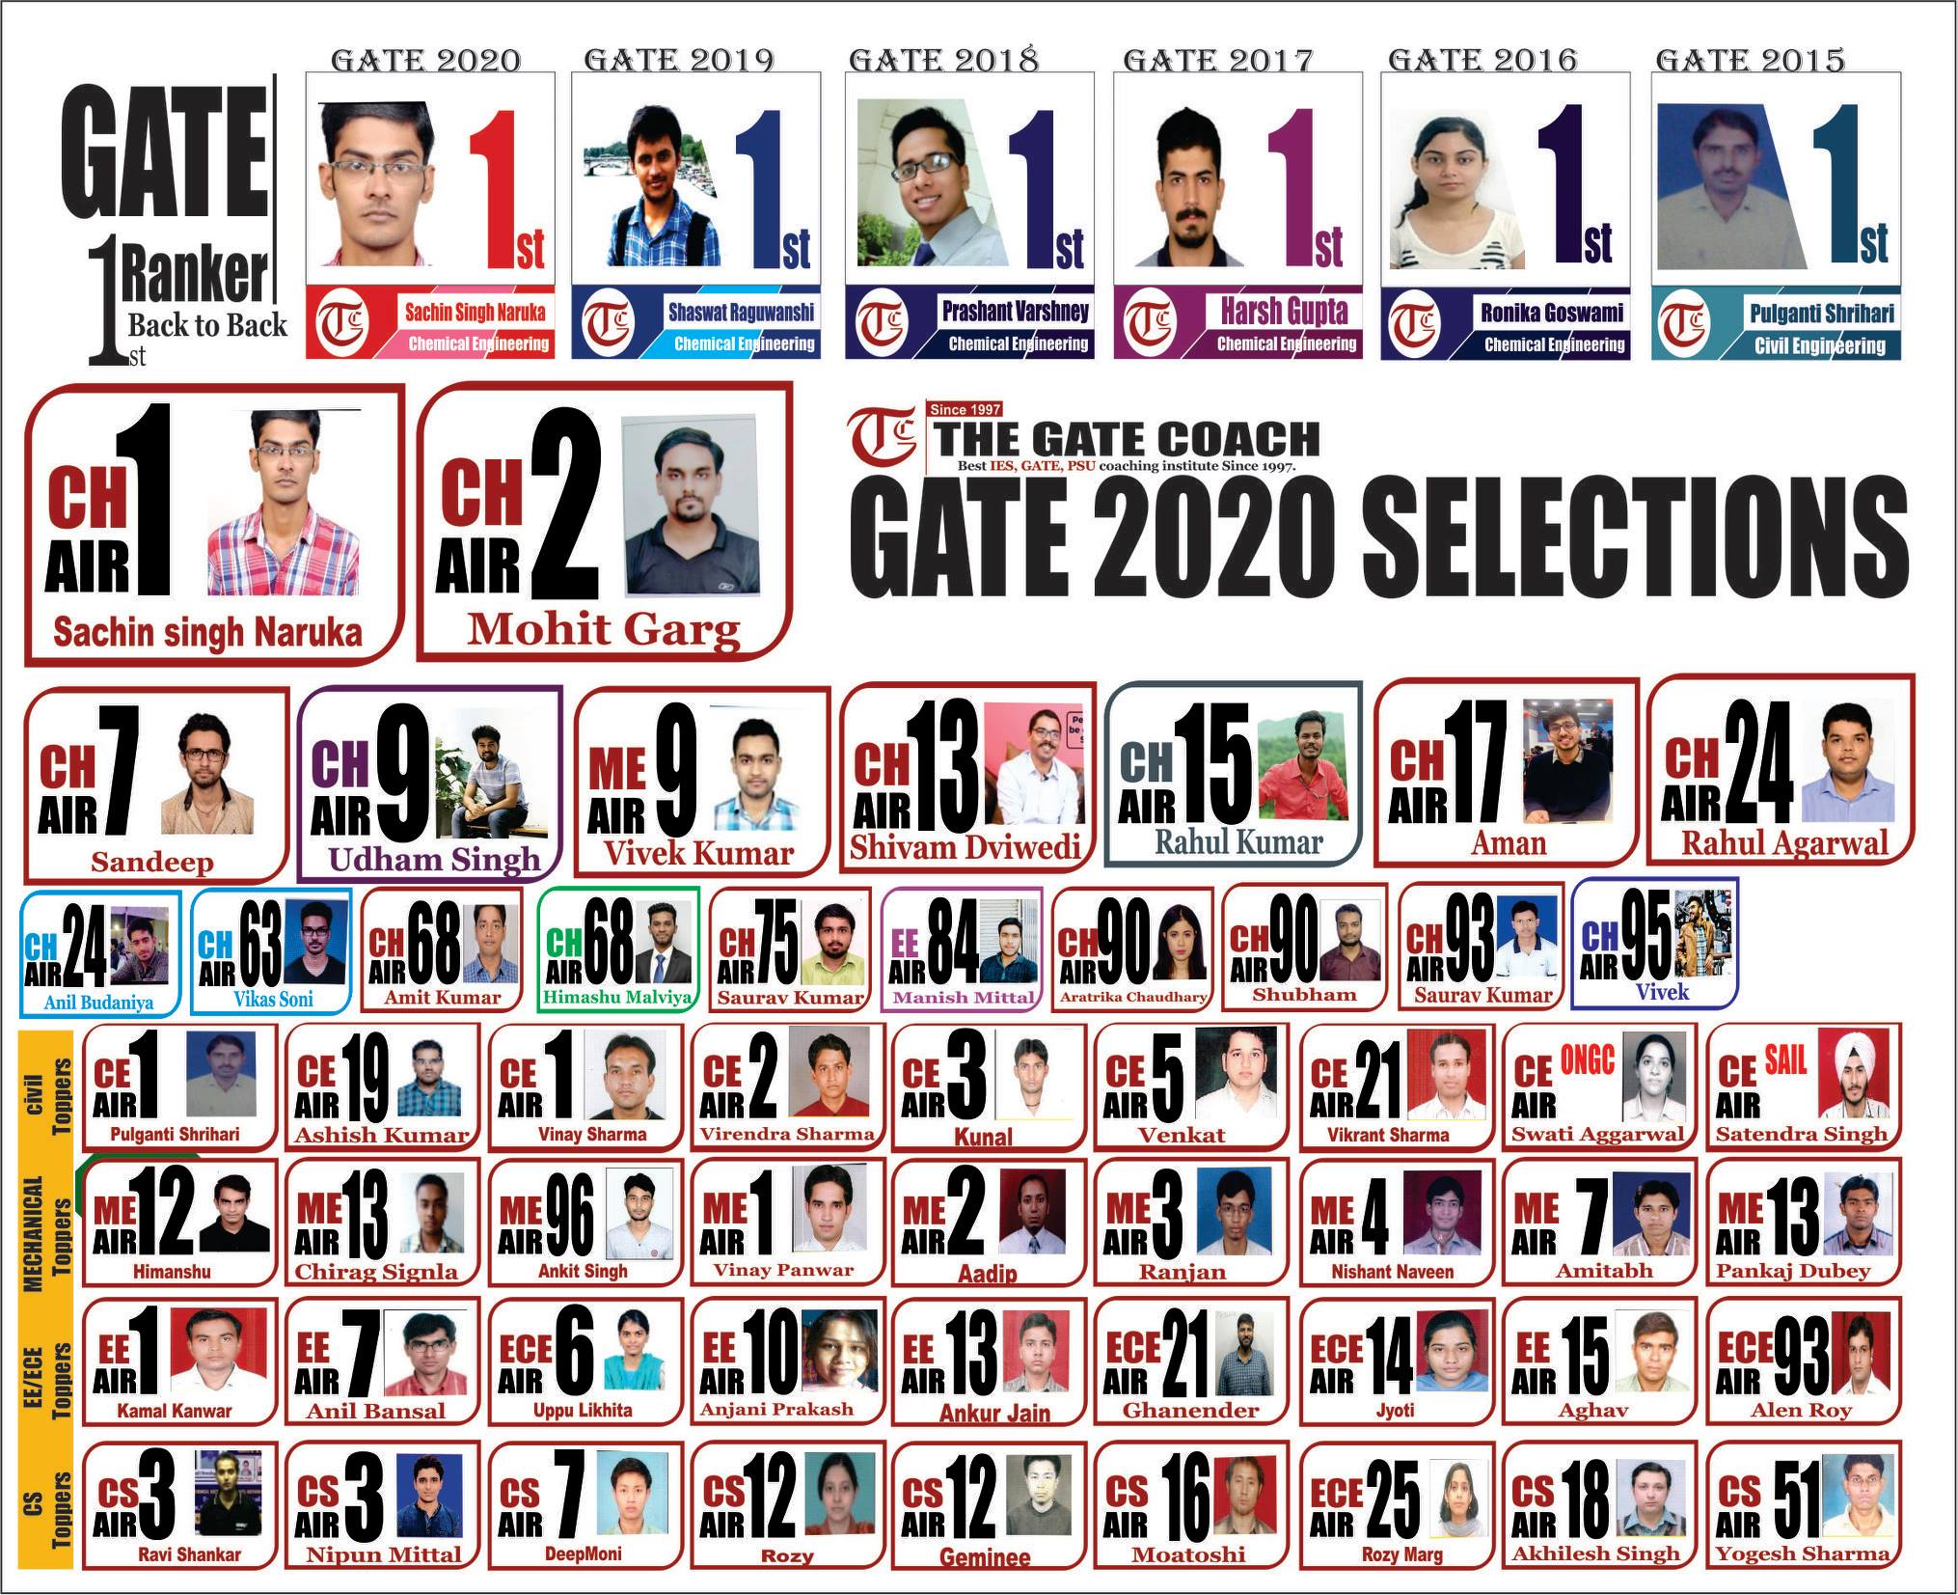

Slide 14
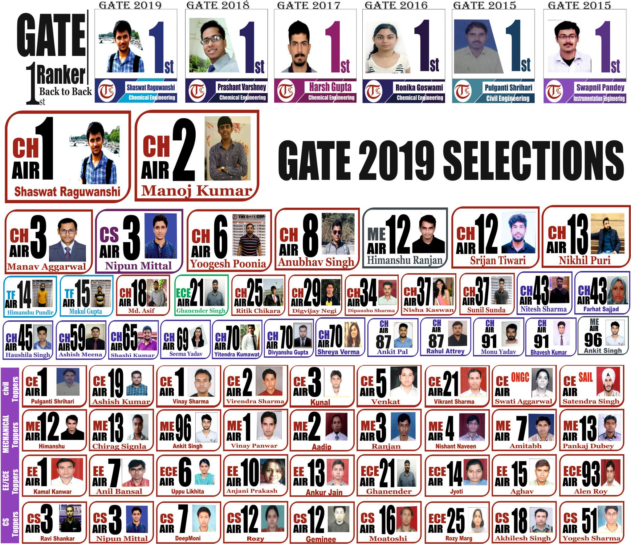

Slide 15
OPEN FORUM
Q & A

Slide 16
TGC DHANBAD CENTRE
Address –
THE GATE COACH
28,JIASARAI, NEAR IIT,
New Delhi-110016
Ph.no. 09873452122, 9818652587

Slide 17
THANK
YOU
The Gate Coach
28, Jia Sarai, Near IIT Delhi
Hauzkhas
Delhi-16
9818652587, 011-26529998
delhi.tgc@gmail.com
web :www.thegatecoach.com
Follow us on Facebook Page “TheGateCoach” 110000 likes

